Slide 1
CEIS 114
Final Project Deliverables PowerPoint
Name: Tylor Rupert
Professor: Alireza Kavianpour
Session: July 2025
Date: 8/28/2025

Slide 2
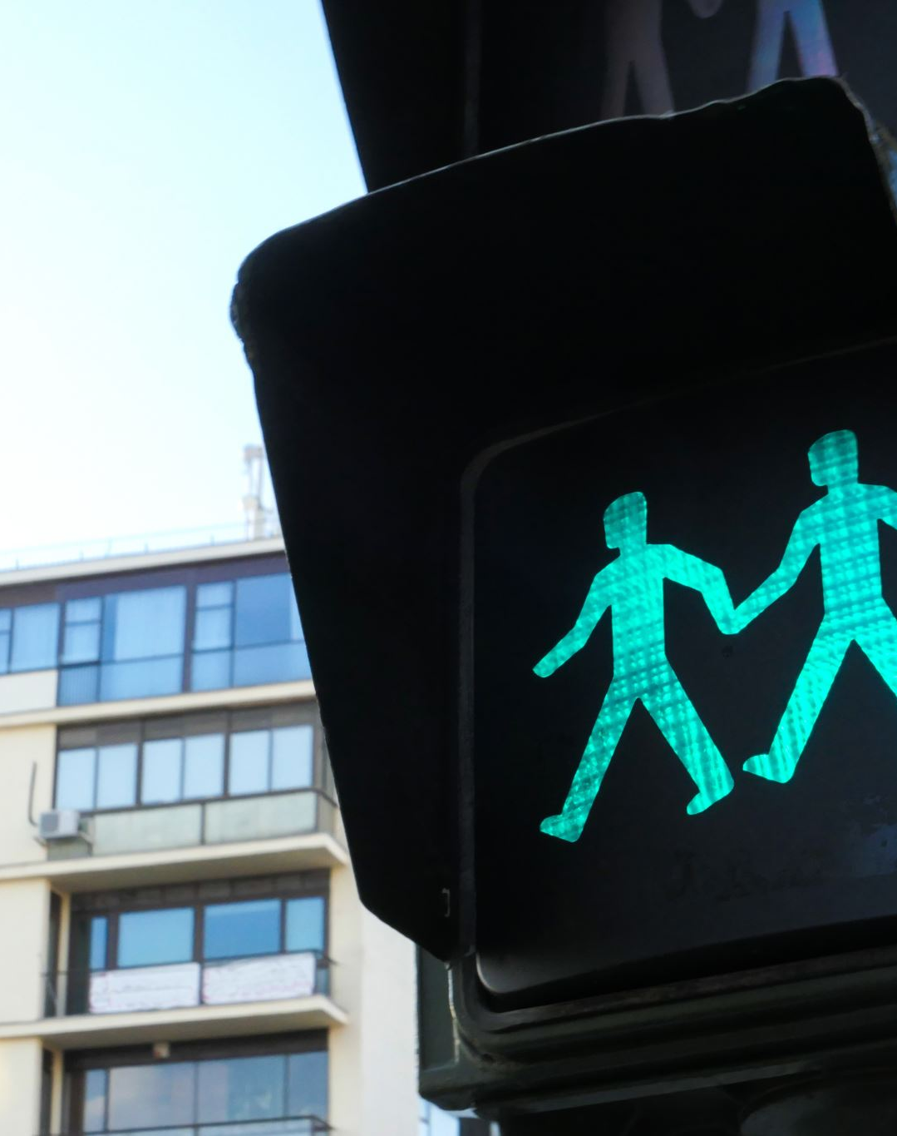
Introductions
Hello class and professors,
welcome to my CEIS 114 project, this is a culmination of week 2 through week 7s projects that have been put together to show the progression of building a traffic light system with several components added onto it that shows how most traffic light in the world are set up.

Slide 3
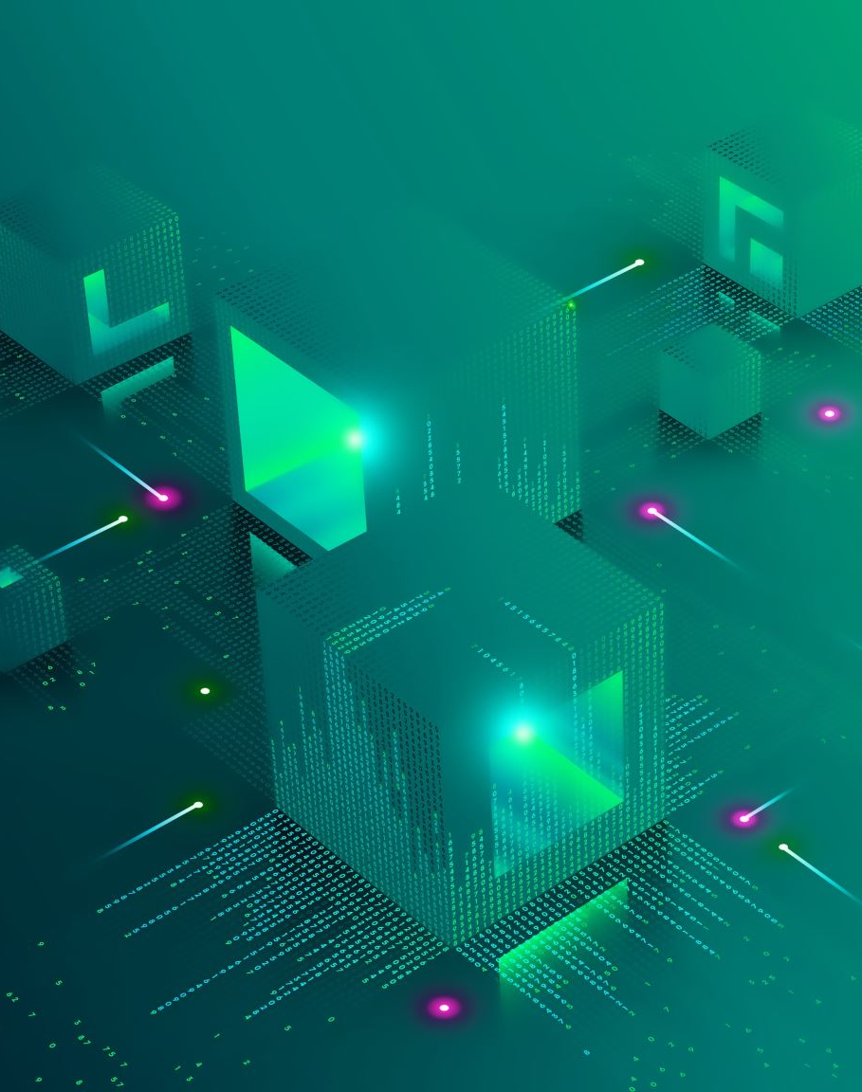
Module 2: Project plan for IoT traffic Controller
In Module 2, we began our project for the semester with setting up our basic ESP32 and breadboard and connected it using a WiFi scanner showing available networks to be used within the Wokwi site for building our future traffic controller.

Slide 4
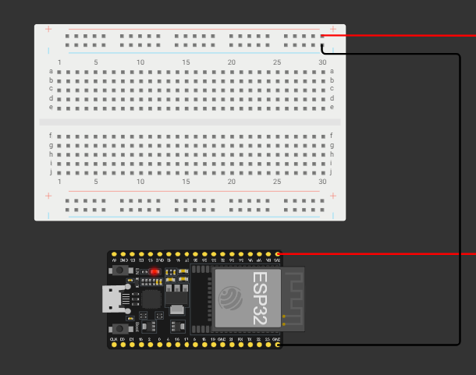
ESP32 (Screenshot)
Week 2 Project: Layout
Microcontroller mounted and powered ON

Slide 5
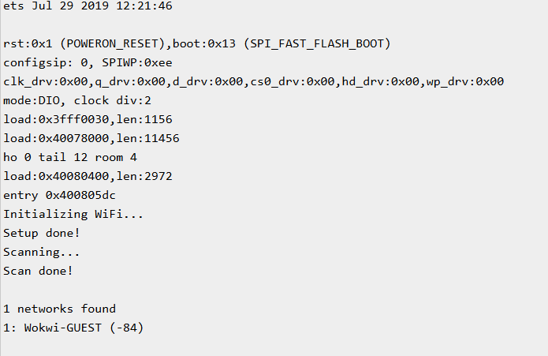
ESP32 WiFi Scan
Week 2 Project: Wifi Scan
Screenshot of Serial Monitor showing the available networks

Slide 6
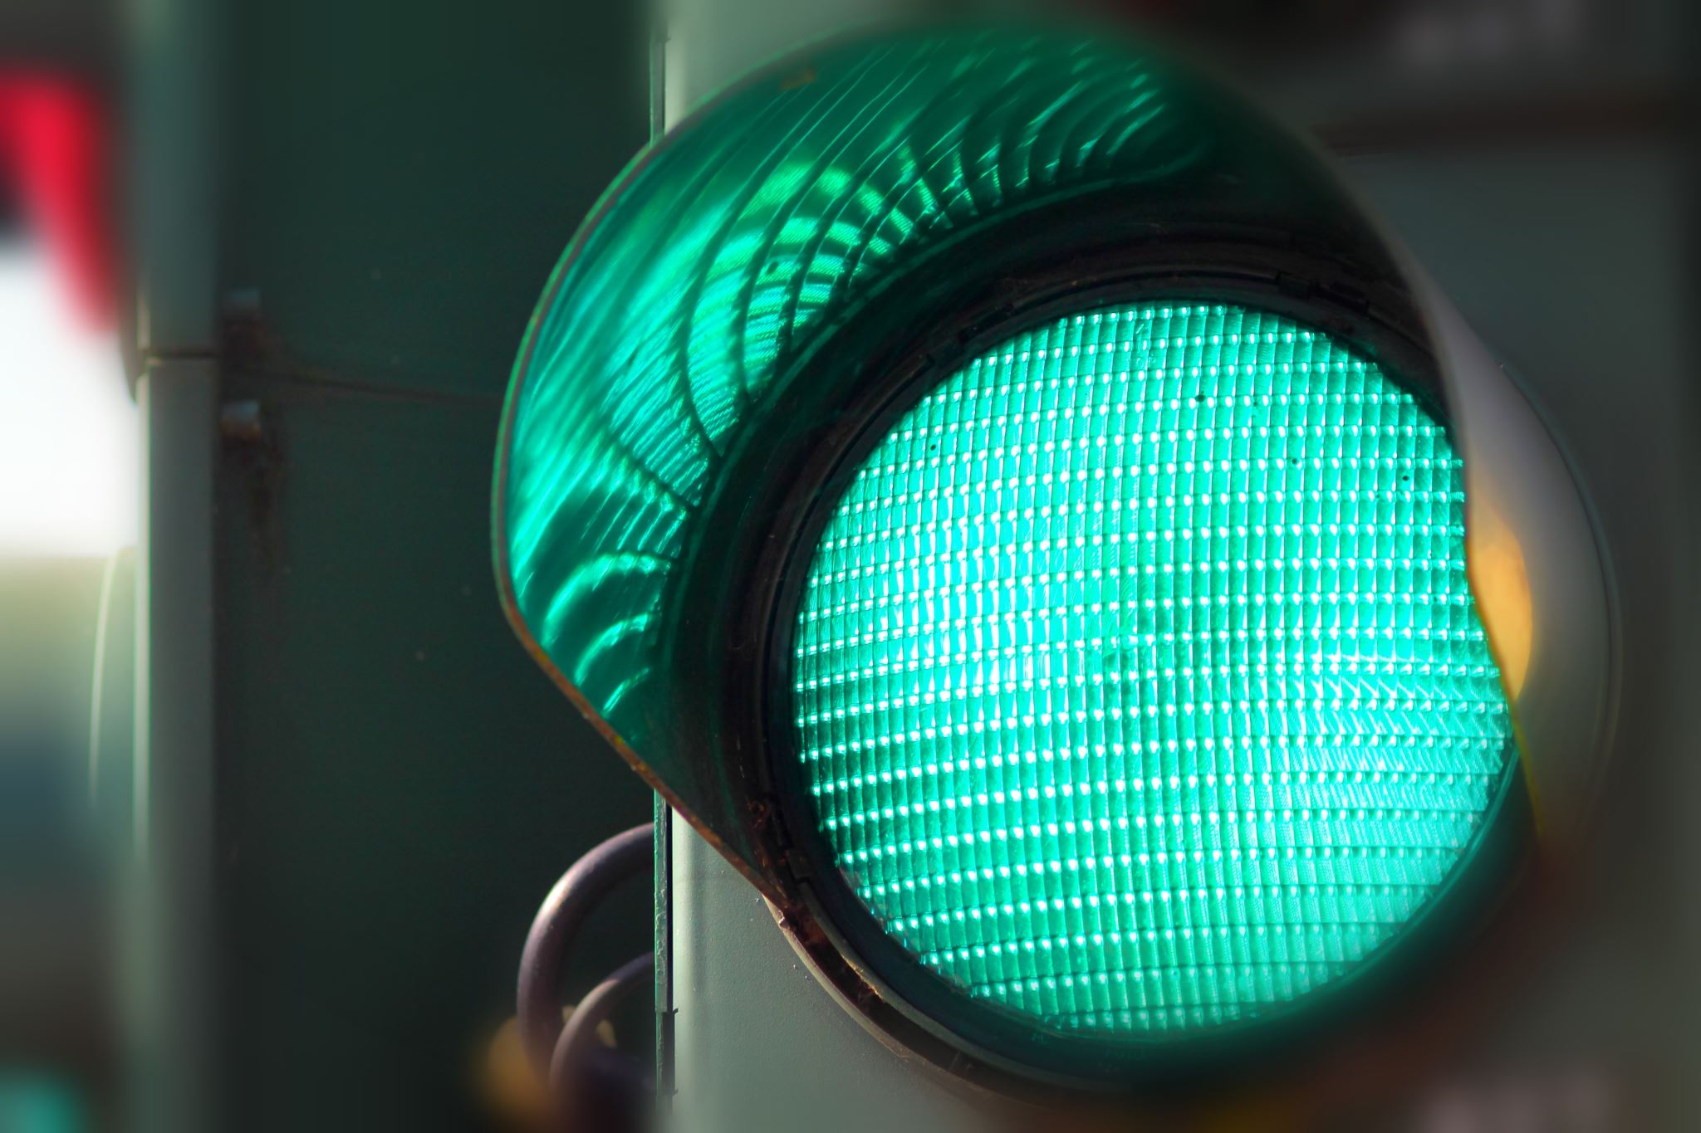
Week 3: Creating the Traffic Controller
In week 3, we created a working LED traffic light system with our ESP 32 board and as well using code to make it switch between which LED lit up indicating a green, yellow, and red light.

Slide 7
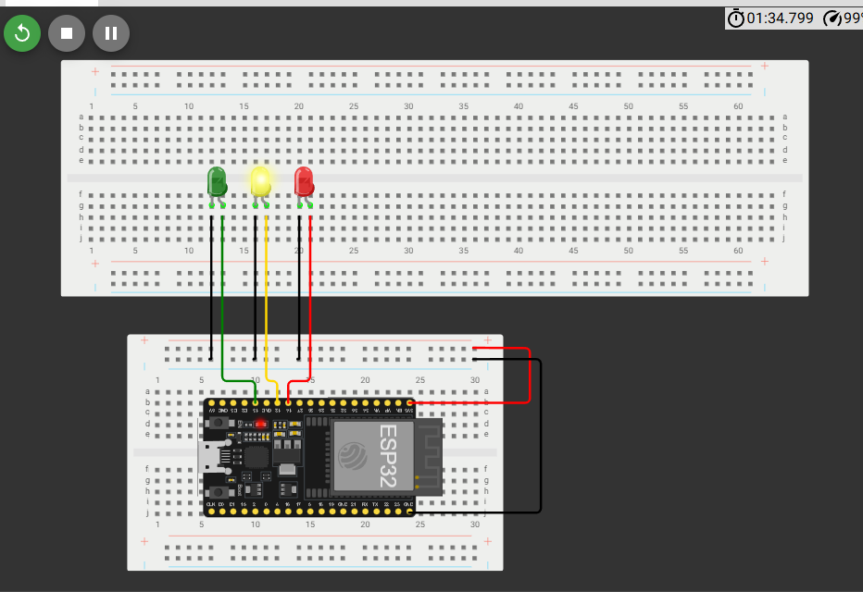
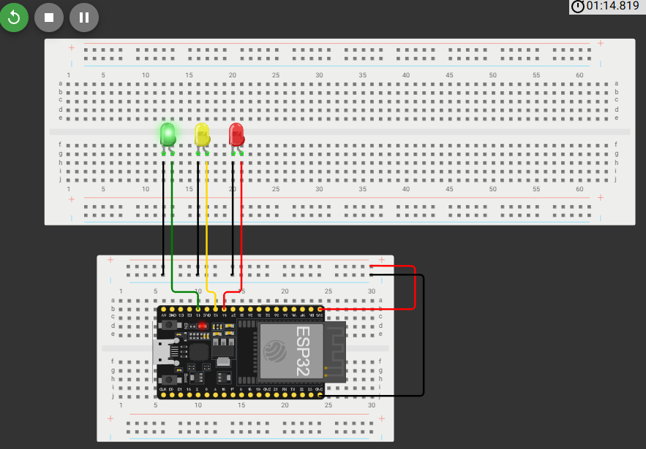
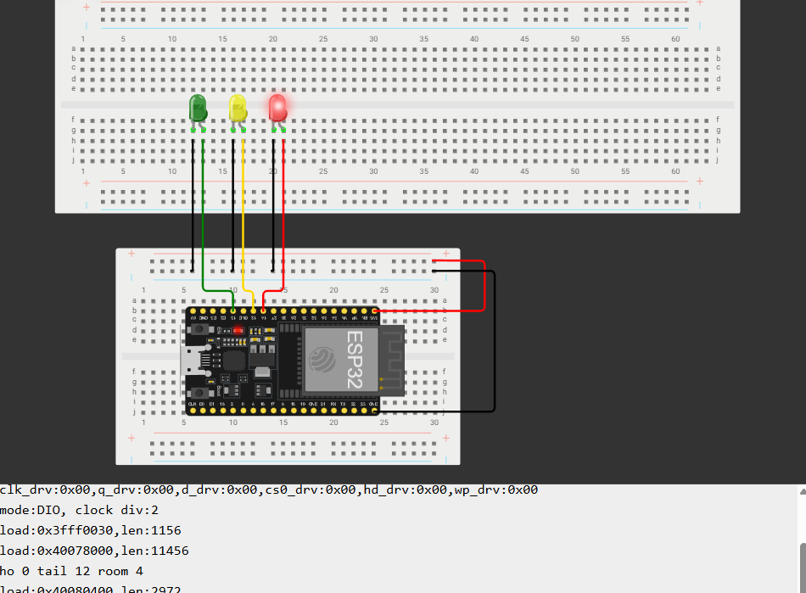
Picture of circuit with working LEDs
Week 3 Project: Layouts
ESP 32 Board
Colored LEDs: Red, Yellow and Green
Wires
Breadboard

Slide 8
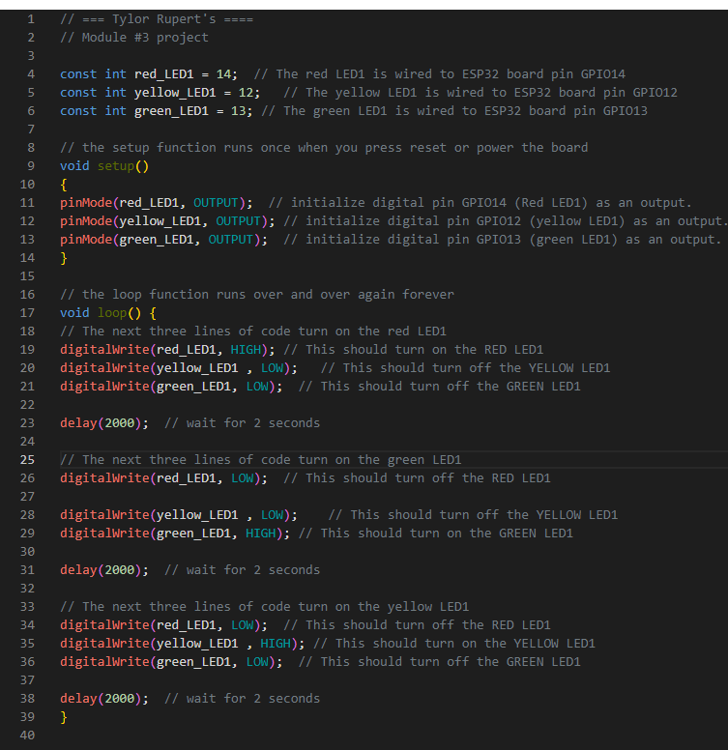
Screenshot of code in the Code Editor
Week 3 Project: Code
Screenshot of code in the Wokwi Code Editor showing your name in the comment

Slide 9
Week 4: Creating a Multiple Traffic Light Controller
In week 4, we setup our breadboard and ESP32 controller to have two sets of traffic lights setup to simulate a multiple light controller you see commonly throughout most towns and cities throughout the world.

Slide 10
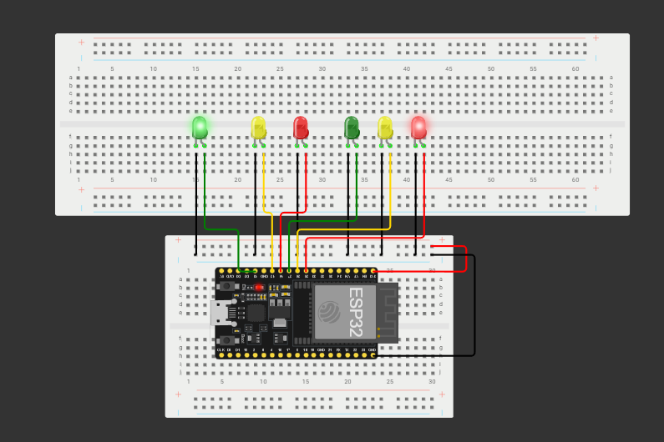
Picture of circuit with working LEDs
Week 4 Project: Layout
ESP 32 Board
Colored LEDs: Red, Yellow and Green (two sets)
Wires
Breadboard

Slide 11
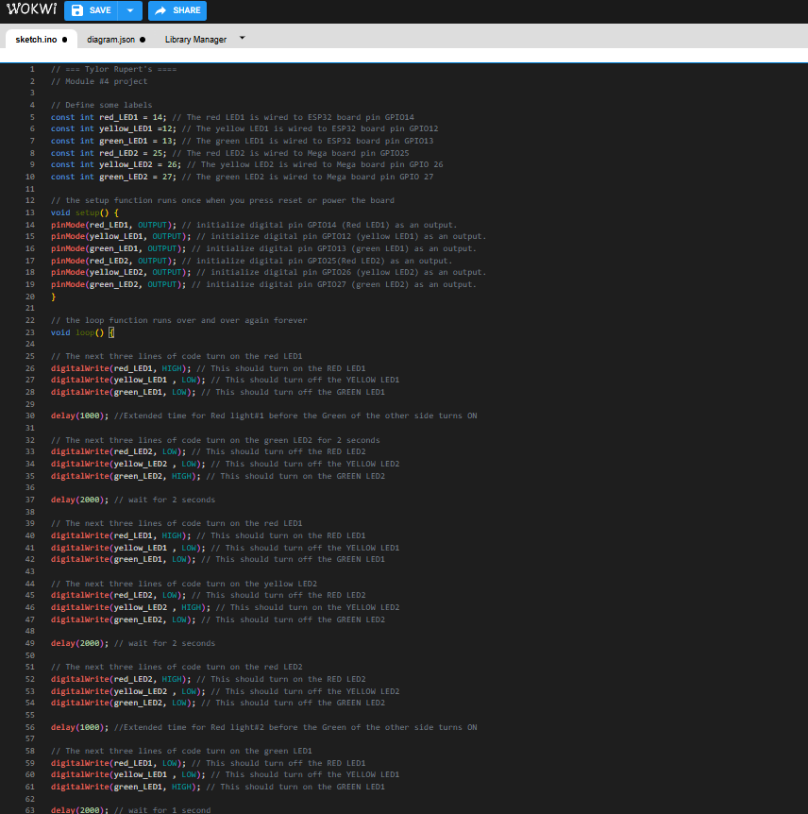
Screenshot of code in Wokwi
Week 4 Project: Code
Screenshot of code Wokwi Code Editor showing your name in the comment

Slide 12
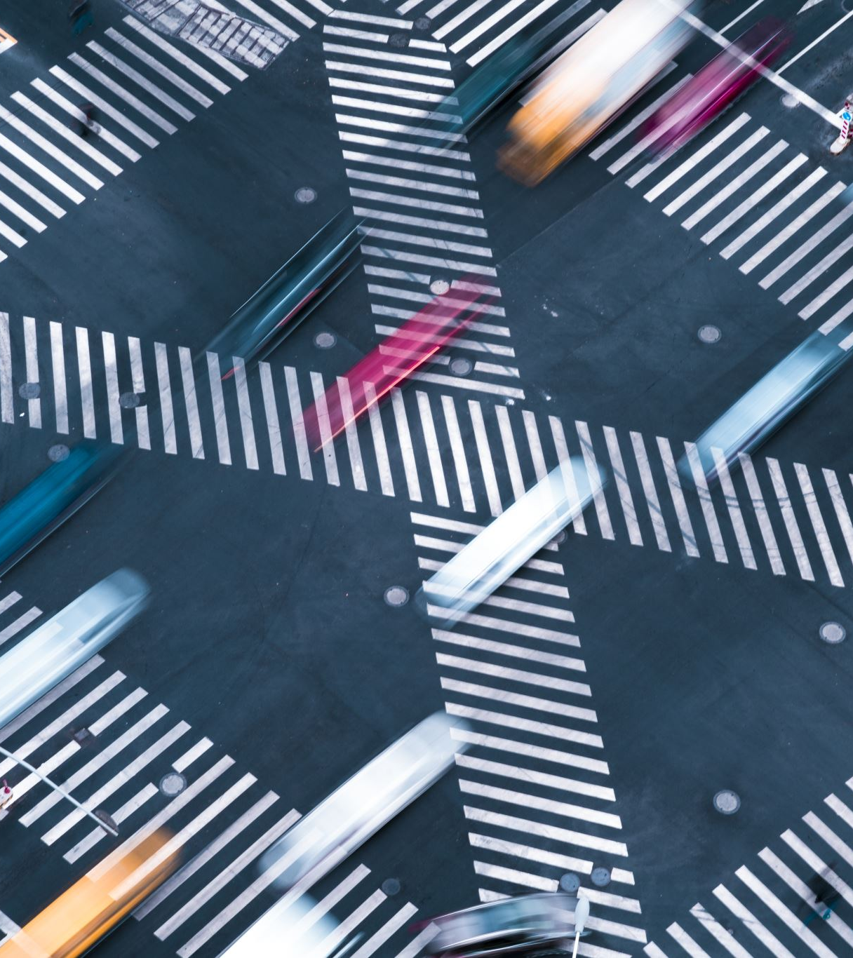
Week 5: Creating a Multiple Traffic Light Controller with a Cross Walk
In week 5, we added on the addition of a button to simulate a cross walk system that has been implemented into several traffic light systems all over the world. Once the button is pressed, once the traffic light changes from one traffic direction to the other, it will simulate allowing people to walk across the street. As well in the serial monitor it will tell you when you are able to cross or not cross by either giving a walk countdown from 10-1 and a *Do Not Walk* message to simulate how it works in real life.

Slide 13
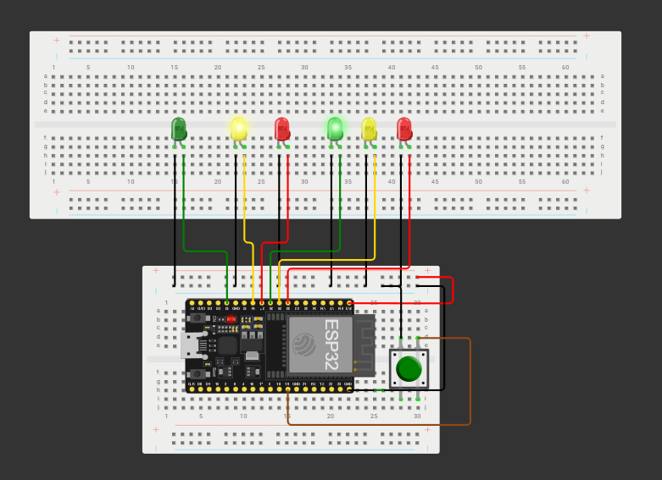
Screenshot of circuit with working LEDs
Week 5 Project: Layout
ESP 32 Board
Colored LEDs: Red, Yellow and Green (two sets)
220 Ohm Resistors (optional)
Push Button
Wires
Breadboard

Slide 14
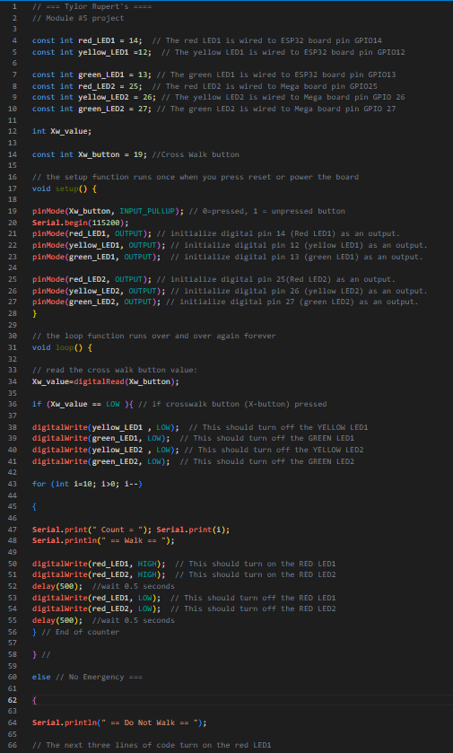
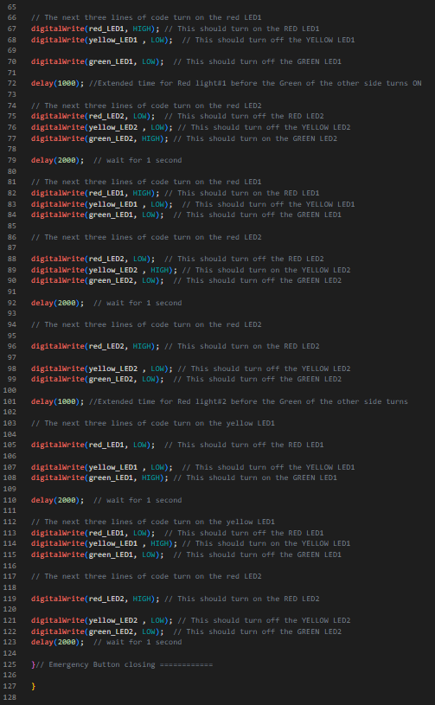
Screenshot of code in Wokwi
Week 5 Project: Code
Screenshot of code in Wokwi Code Editor showing your name in the comment

Slide 15
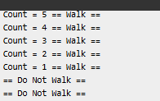
Screenshot of Serial Monitor in Wokwi
Week 5 Project: Serial Monitor
Screenshot of output in Serial Monitor

Slide 16
Week 6: Creating a Multiple Traffic Light Controller with a Cross Walk and an Emergency Buzzer
In week 6, we added onto our traffic light system a LCD display and a buzzer to show a countdown clock and as well when people are able to walk and not walk. Also giving them an audio que on when to walk as well so they do not have to rely on just the LCD screen to tell them when to cross or not cross.

Slide 17
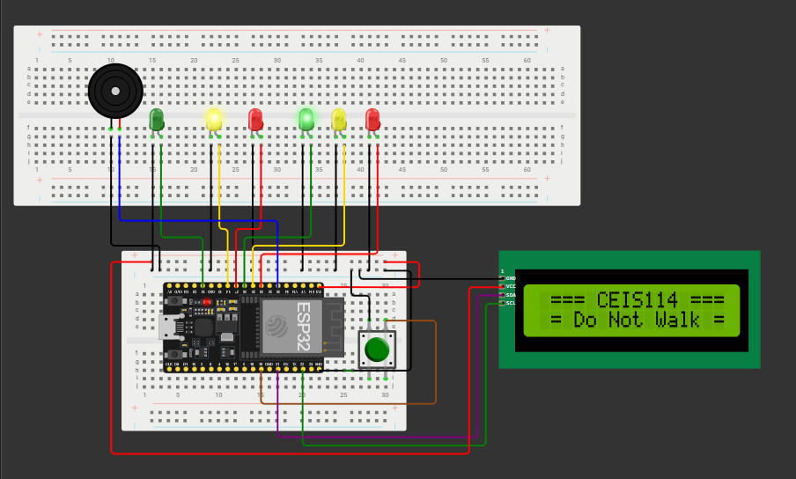
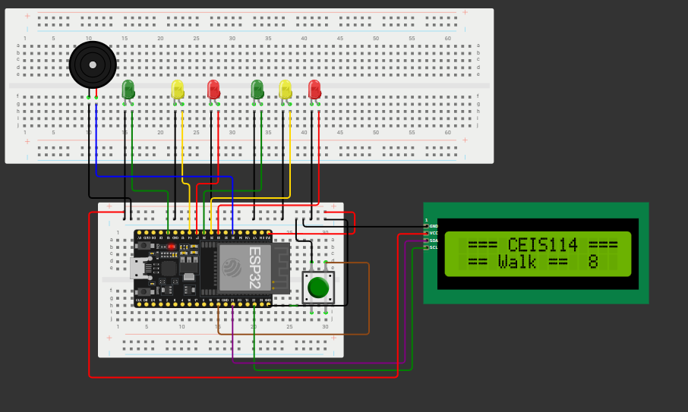
Picture of circuit with working LEDs and LCD display
Week 6 Project: Layout
ESP 32 Board
Colored LEDs: Red, Yellow and Green (two sets)
220 Ohm Resistors (optional)
Push Button
LCD Unit with Message Display
Wires
Breadboard

Slide 18
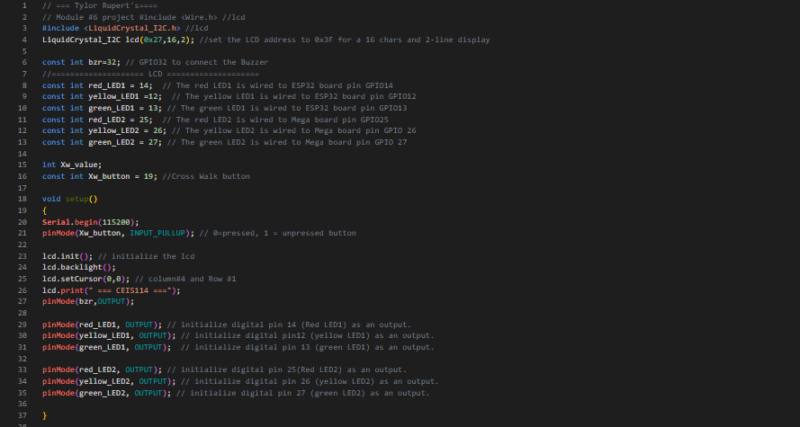
Screenshot of code in Code Editor
Week 6 Project: Code
Screenshot of code in Code Editor showing your name in the comment

Slide 19
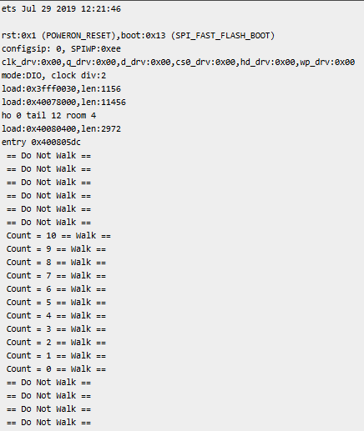
Screenshot of Serial Monitor
Week 6 Project: Serial Monitor
Screenshot of output in Serial Monitor

Slide 20
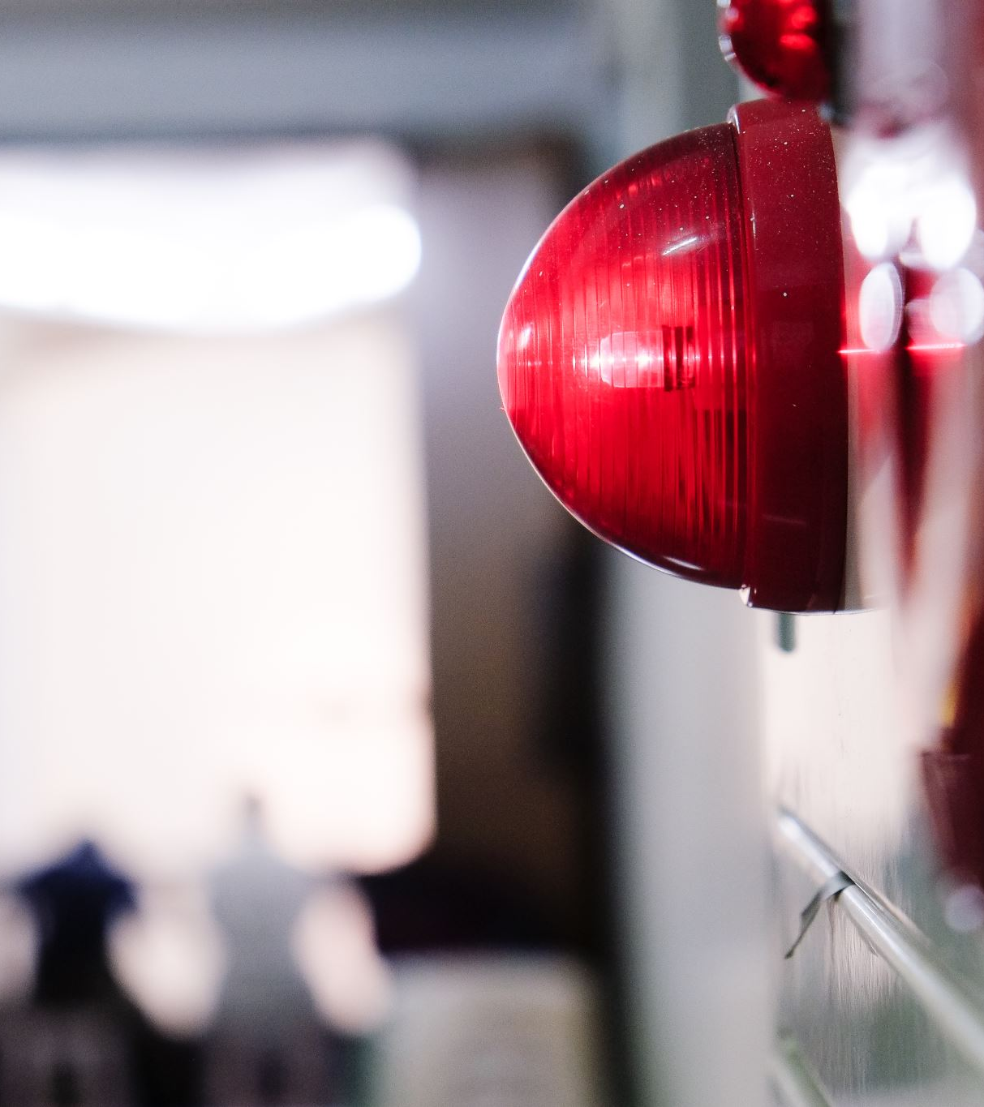
Week 7:Creating a Multiple Traffic Light Controller with a Cross Walk and an Emergency Buzzer with secured IoT Control via Web
In week 7, we added onto our traffic light controller for the last time. In this addition, we added a emergency buzzer and as well a set line of code that would allow us to send a message to the traffic light controller to turn on the emergency light and show a emergency message on the LCD screen showing that an emergency is happening at this traffic light and to watch out for any incidents happening. We were able to use the IoT MQTT panel app on our phones to send that message to our traffic light simulation indicating that we have triggered a emergency message to display.

Slide 21
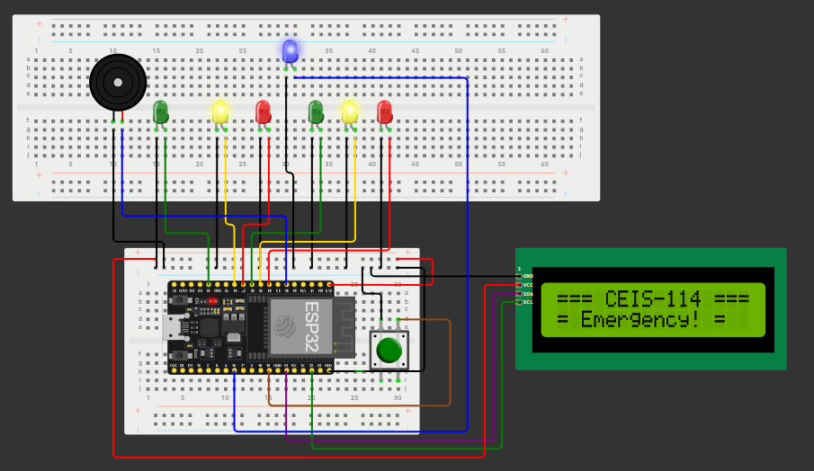
Screenshot of circuit with working LEDs and LCD display (Building/Operation)
Week 7 project: layout
ESP 32 Board
Colored LEDs: Red, Yellow and Green (two sets)
One Blue LED – Emergency Light
Push Button
LCD Unit
Buzzer
Wires
Breadboard

Slide 22
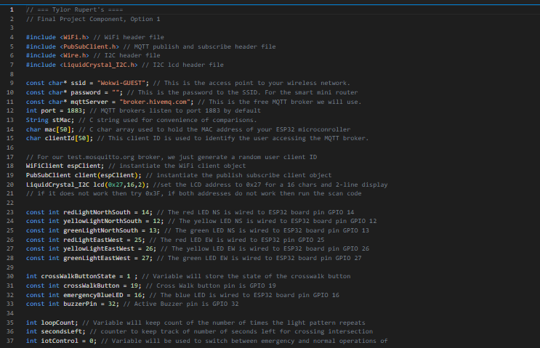
Screenshot of code in Code Editor (Testing)
Week 7 project: Coding
Screenshot of code in Code Editor showing your name in the comment

Slide 23
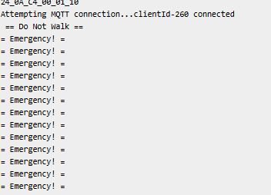
Screenshot of Serial Monitor (Testing)
Week 7 project: serial Monitor
Screenshot of output in Serial Monitor

Slide 24
Challenges I faced this class
This Class I have honestly faced a lot of challenges both with school and my own personal life. During this class I started going to DeVry full time while already as well working my job full time which with that came trying to balance work, school, my social life, family life, and my own happiness. This I did find difficult from time to time because when I would focus hard in school, my social life and sometimes my own happiness would decline due to my work and school effort being the main focus some weeks, which came with a lot of challenges like cancelling plans with friends, doing homework at work and watching lessons to try and keep up and understand what I’m trying to learn currently. It really was a struggle some weeks but once I found a good grove I honestly started to improve and become a bit happier as the weeks went by.

Slide 25
My Career Skills
The Skills I took from this class will help me progress in my engineering degree and will help me better understand on how coding can effect systems and stress the importance of having a properly setup system can be advantageous. As well, I will be taking the knowledge I gained from this class and use it to better myself at my work. I am currently working at a two way radio company and one of my projects I took onto myself is trying to design a handheld radio that for one, will try and compete with a lot of the bigger companies today but make it to where it is cost effect for us to manufacture here in the US and as well make it affordable enough to where our customers who need a reliable two way radio will not have to spend an arm and a leg to buy one that will hold up the test of time and be reliable in their day to day operations.

Slide 26
CEIS 114 Final project conclusion
In conclusion to this project, I will be taking all the knowledge I have gathered from this class and will be applying it to my future engineering classes and in the future, will be able to look back on this and hopefully apply what I've learned into my professional career in the radio world and design and engineer two way radios that customers will find reliable, cost effective and easy to use no matter what kind of background they have with using radios.
In addition, my project will be posted on my wix page, you can find it at https://www.thewatchersgrotto.com/

